Slide 1
Statistical Learning and Data Analysis Assignment 3: Regression and Data Simulation

Slide 2
Objectives of the Assignment
This assignment studies different regression techniques using simulated datasets.
Main goals:
Evaluate linear regression using data with known structure
Verify if important predictors can be identified
Analyze model assumptions through regression diagnostics
Study regularization techniques (Ridge, Lasso, Elastic Net)
Understand non-linear regression and the bias–variance trade-off

Slide 3
Data Simulation
We generate a dataset with
Where
n = 300 observations
p = 10 predictorsa
The data generating model is:
y = β0 + β1X1 + β2X2 + ... + β10X10 + ε
Some predictors have strong effects
Some have small effects
Others have zero coefficients (noise variables)
Gaussian noise is added to simulate real-world uncertainty.

Slide 4
Linear Regression Results (OLS)
An Ordinary Least Squares regression model was fitted to estimate the relationship between predictors and the response.
Main observations:
Strong predictors (X1, X2, X3) are highly significant
Moderate predictors (X4, X5) show weaker but detectable effects
Noise variables (X6–X10) are correctly identified as non-significant
Conclusion: The linear regression model successfully recovers the true structure of the simulated data.

Slide 5
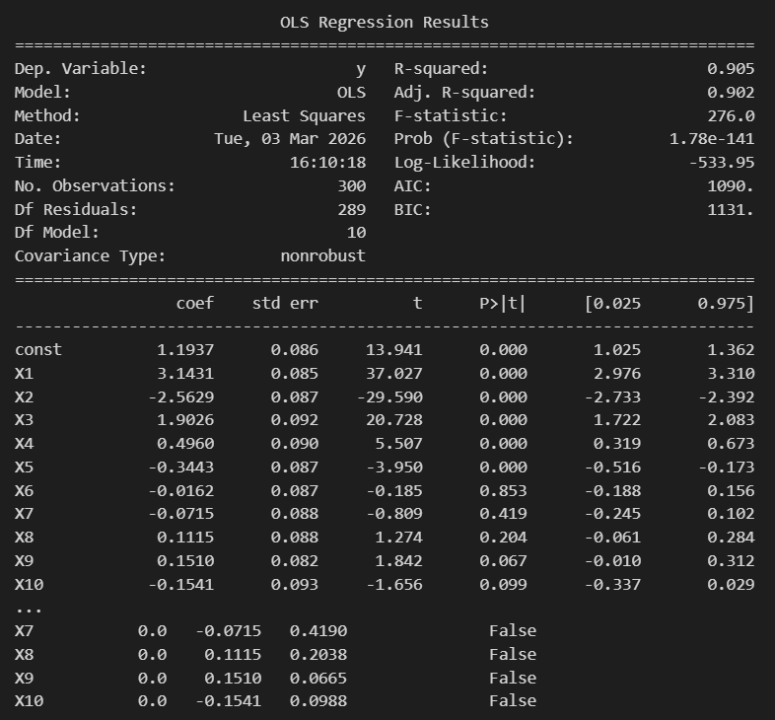
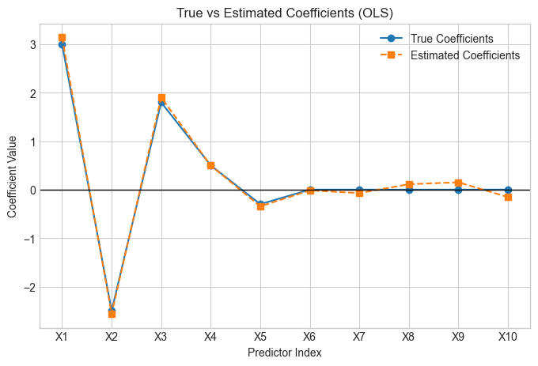
Linear Regression Results (OLS)
OLS Regression Results
True vs Estimated Coefficients (OLS) plot

Slide 6
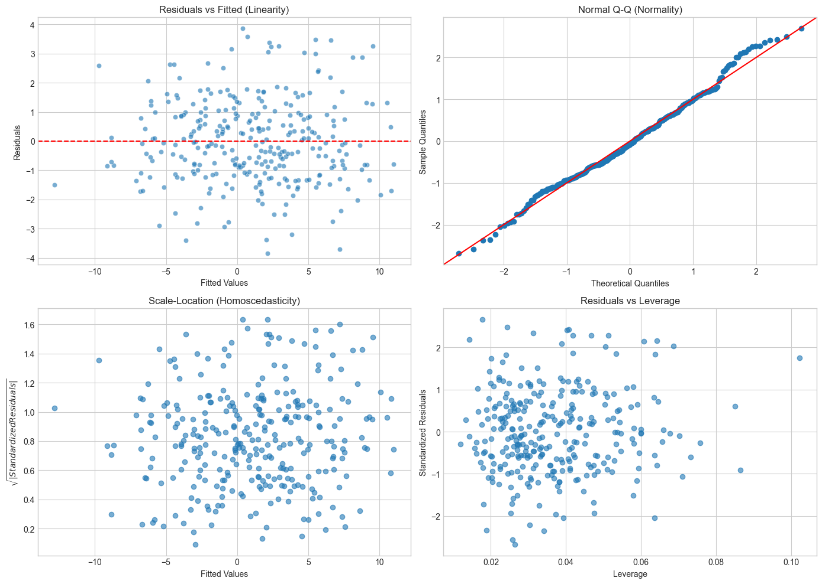
Regression Diagnostics
Regression diagnostics are used to verify model assumptions.
Key observations:
Residuals vs Fitted → No systematic pattern, suggesting linearity
Q-Q Plot → Residuals approximately follow the normal distribution
Scale-Location → Variance appears constant
Residuals vs Leverage → No influential outliers detected
Conclusion: The OLS model assumptions are reasonably satisfied.

Slide 7
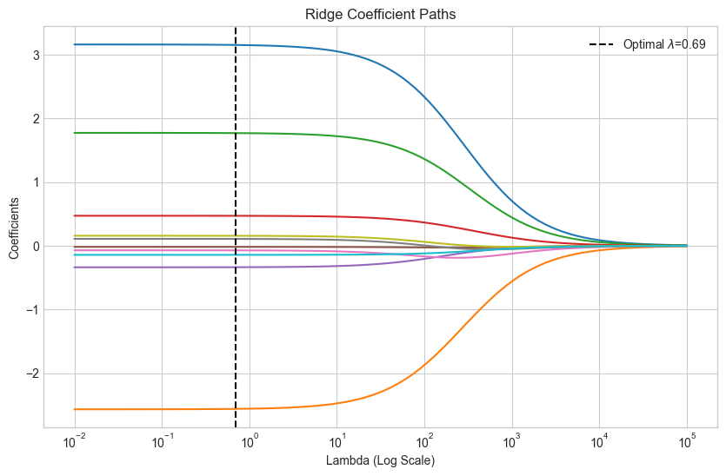
Ridge Regression
Ridge regression applies an L2 penalty on the coefficients.
Objective:
Minimize: RSS + λ Σ β²
Observations:
All coefficients shrink toward zero
Strong predictors remain relatively large
Noise predictors are reduced but not eliminated
Conclusion: Ridge improves model stability but does not perform variable selection.

Slide 8
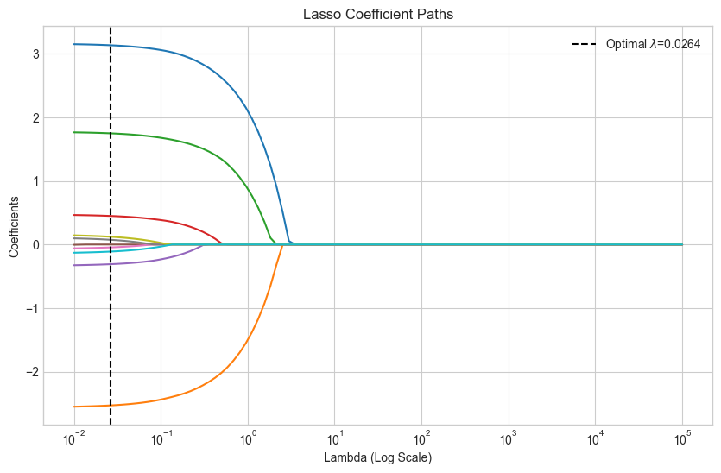
Lasso Regression
Lasso regression uses an L1 penalty on the coefficients.
Objective:
RSS + λ Σ |β|
Observations:
Some coefficients shrink exactly to zero
Noise variables are removed from the model
Strong predictors remain non-zero
Conclusion: Lasso performs automatic feature selection.

Slide 9
Elastic Neta
Elastic Net combines both Ridge and Lasso penalties.
Penalty function:
λ ( α Σ |β| + (1−α) Σ β² )
Observations:
Balances shrinkage and variable selection
Provides more stable estimates when predictors are correlated
In this simulation it behaves similarly to Lasso.

Slide 10
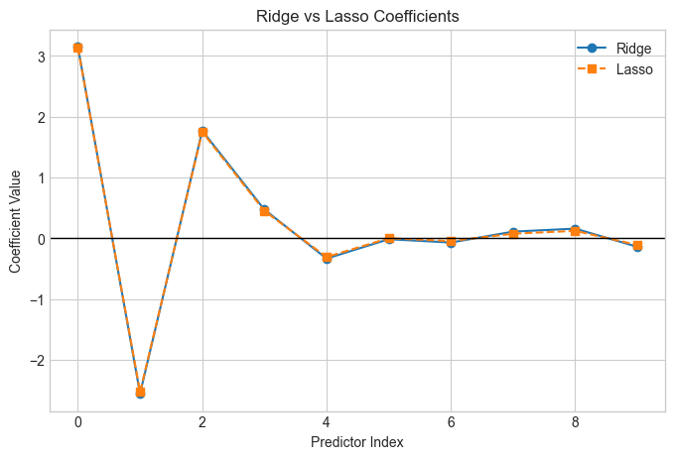
Comparison of Regularization Methods
Comparison of regression models:
OLS
Accurate when assumptions hold
Higher variance
Ridge
Reduces variance
Keeps all predictors
Lasso
Performs variable selection
Produces sparse models
Elastic Net
Combines advantages of Ridge and Lasso

Slide 11
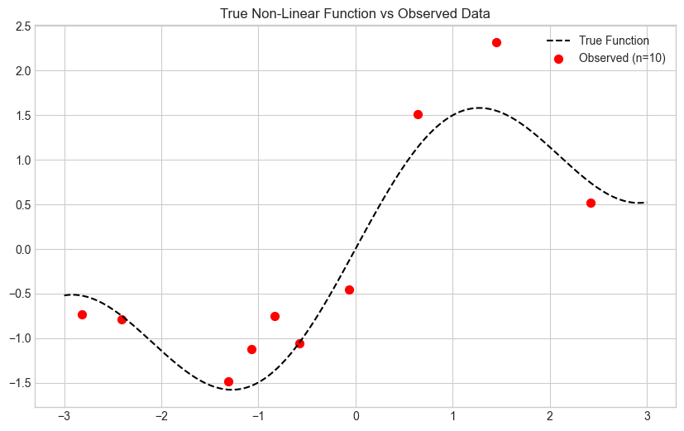
Non-Linear Data
A non-linear dataset was simulated using a sinusoidal function.
Characteristics:
n = 10 observations
Random noise added
The underlying pattern is difficult to estimate with limited data.
This dataset is used to study overfitting and model flexibility.

Slide 12
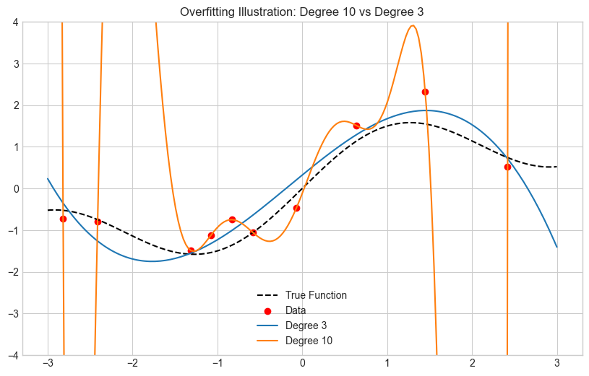
Polynomial Regression & Overfitting
Two polynomial models were fitted:
Degree 3 model
Smooth curve
Better generalization
Degree 10 model
Passes through all training points
Strong oscillations
Clear example of overfitting
This illustrates the bias–variance trade-off.

Slide 13
Effect of Sample Size
When sample size increases (n = 150):
Degree 10 model becomes smoother
Overfitting decreases
The model approximates the true function more accurately
SVR vs Decision Tree
Decision Tree → step-like predictions
SVR → smoother approximation
Conclusion: More data helps complex models generalize better.

Slide 14
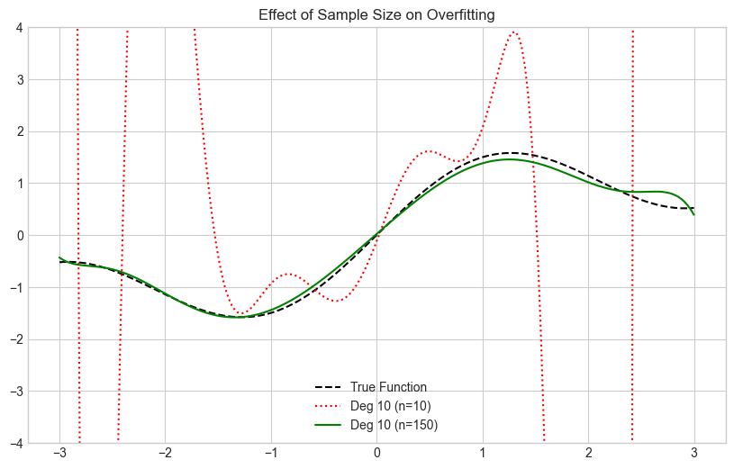
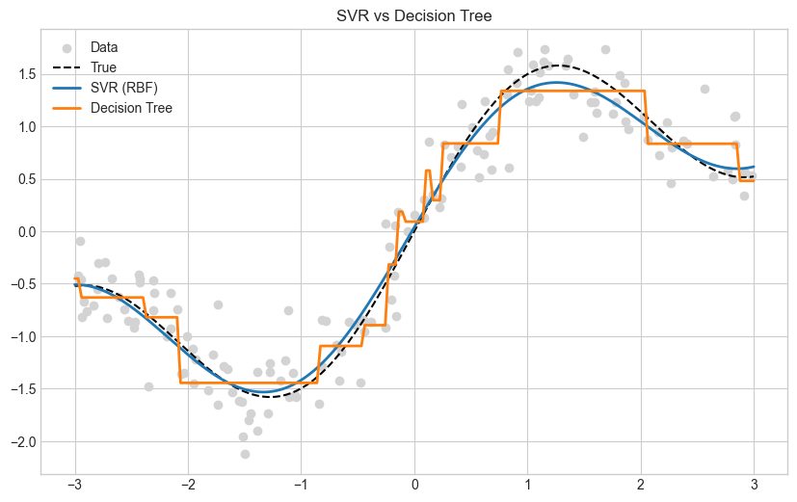
Effect of Sample Size

Slide 15
Thank You

